Slide 1
Computer Vision with Embedded Machine Learning
What is Computer Vision?

Slide 2
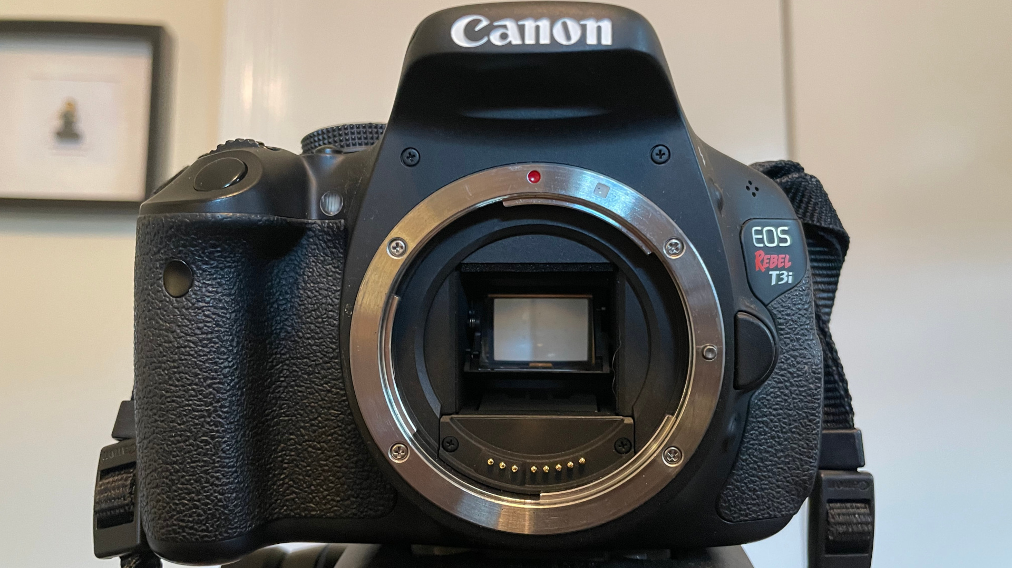
CMOS Image Sensor
Light

Slide 3



Microcontroller
Lens(es)
Image Sensor
Light
200
209
199
198
201
203
204
201
199
200
202
201
41
42
44
43
44
45
22
23
30
31
208
199
44
44
40
42
42
44
16
17
18
12
32
15
36
197
33
14
35
209
22
23
30
31
33
43
14
20
25
27
25
29
Blue
33
32
35
36
33
43
22
23
30
31
33
35
Green
33
32
35
36
33
35
Red

Slide 4



Slide 5
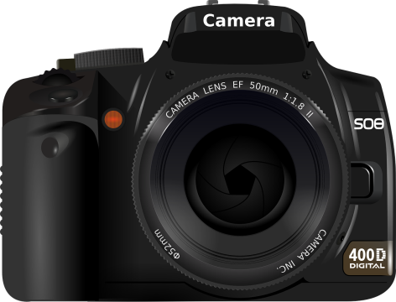
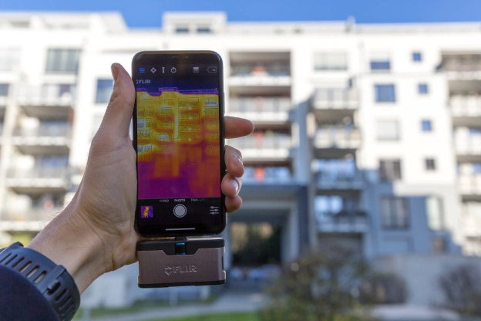
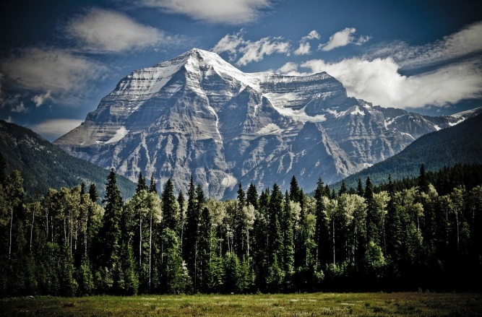
“Thermal image of a building”, by Marco Verch (CC BY 2.0)

Slide 6
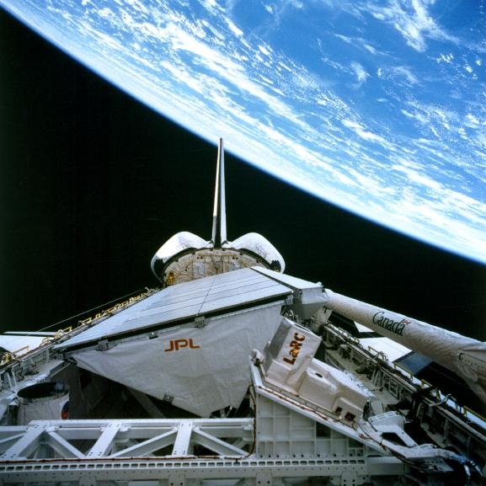
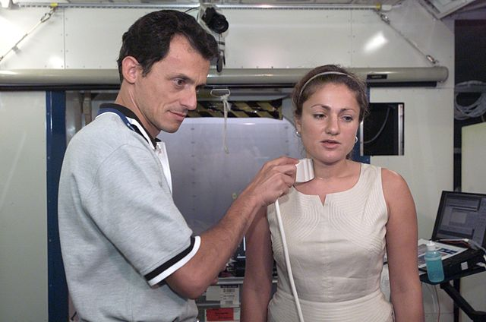
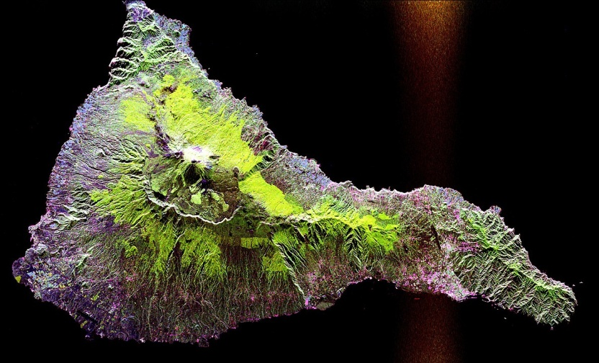
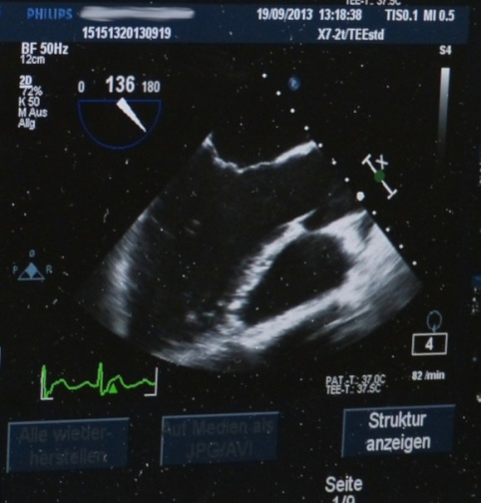
SIR-C/X-SAR imaging radar on Space Shuttle Endeavour
Teide volcano

Slide 7



Window
Tree
Predicted
Lava flow
Tumor

Slide 8



Slide 9
Artificial
Intelligence
Computer
Vision
Machine
Learning
We are here

Slide 10
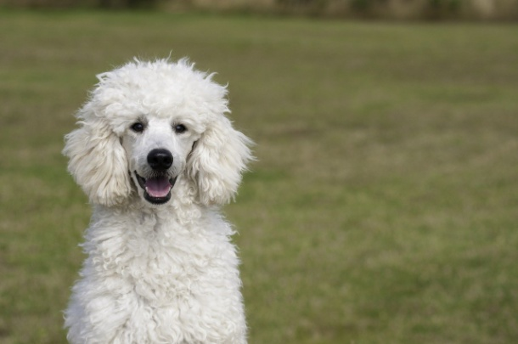

Image Classification
Model
dog
cat

Slide 11

Image Classification
Model
dog?

Slide 12
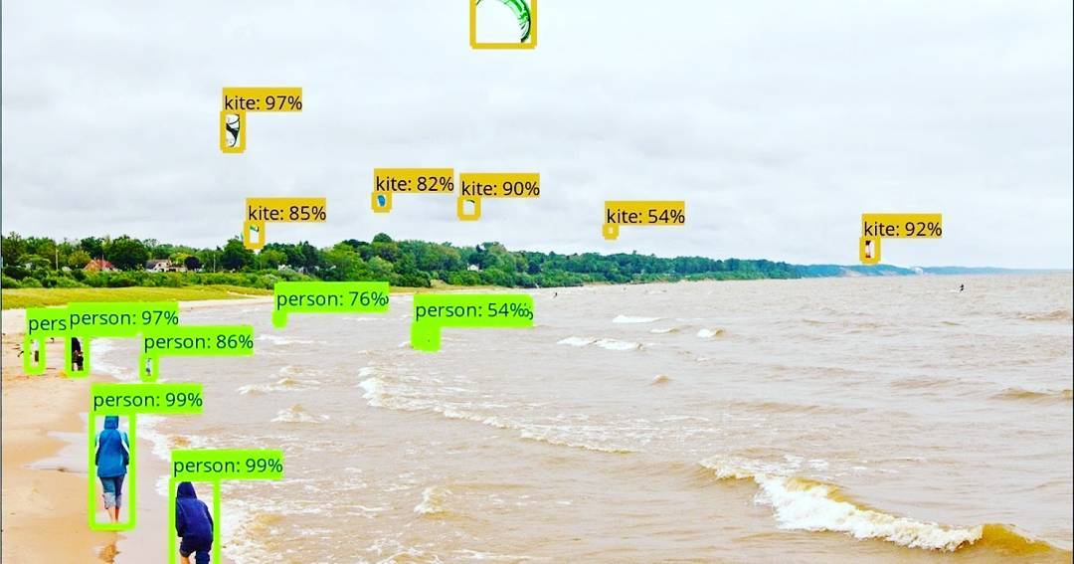
Object Detection
“The future of computer vision,” by ShashiBellamkonda (CC BY 2.0)

Slide 13


240 x 240 x 8 x 30 x 1 =
13.824 Mbps
Number of pixels
Num. cameras
Bits per pixel
Frames per second

Slide 14
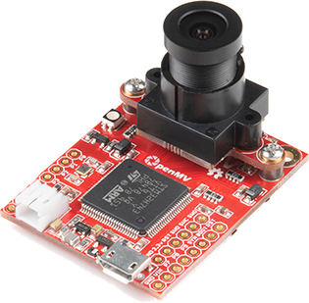
“OpenMV H7 Camera”, by SparkFun Electronics (CC BY 2.0)
1 x 30 x 1 =
30 bps
Num. cameras
Person or
not person
Frames per second

Slide 15
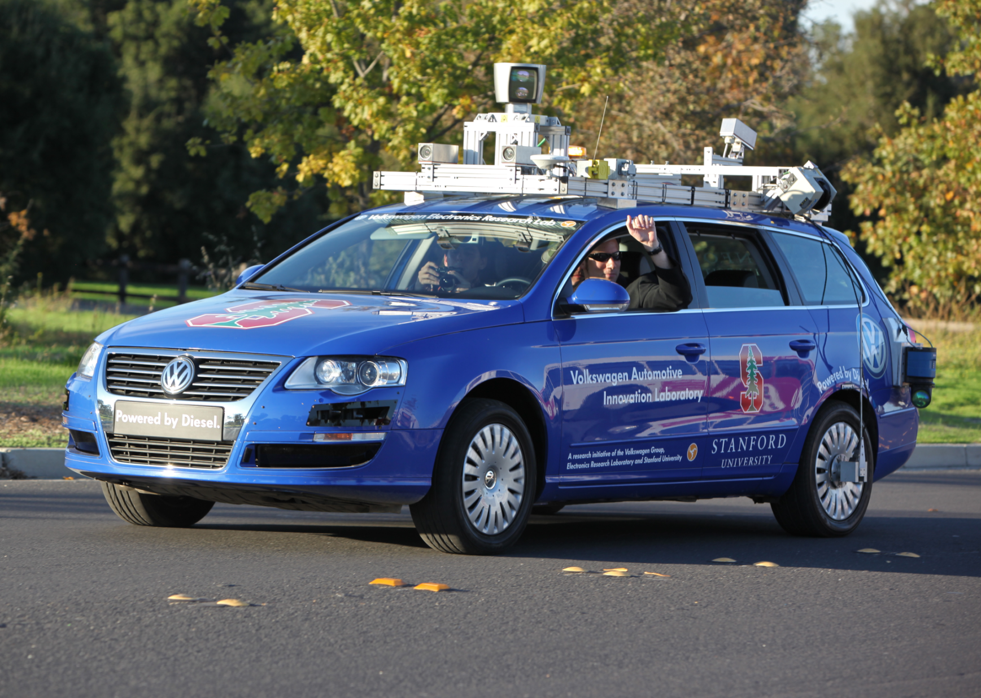
“Hands-free Driving” by Steve Jurvetson (CC BY 2.0)

Slide 16


Slide 17
Trust in AI
Lawful
Ethical
Robust

Slide 18

Trust in AI

Slide 19
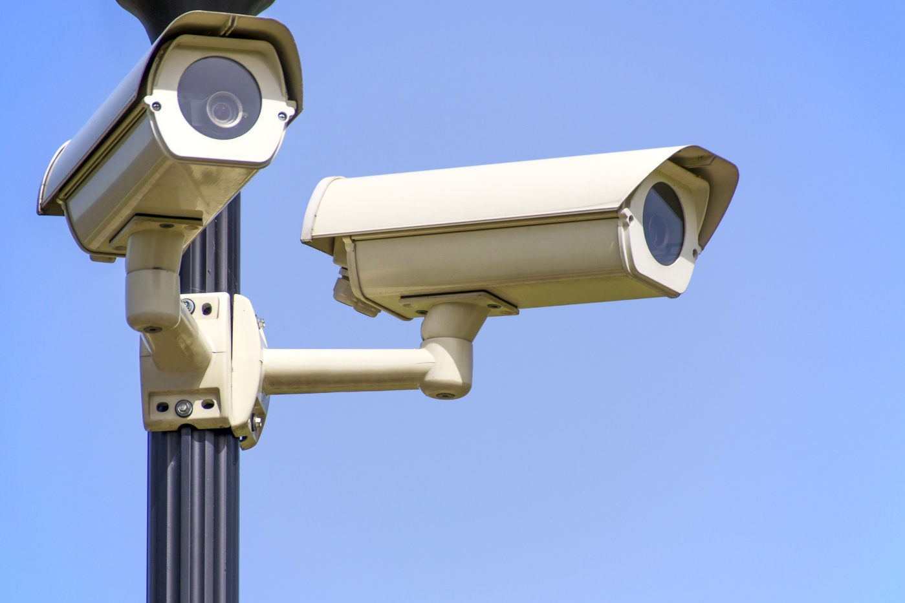
Trust in AI

